Slide 1

Probabilistic Graphical Models
Project Presentation
Shelly Jain
Sayar Ghosh Roy

Slide 2
A note on bounds for VC dimensions
Aad van der Vaart, Jon A. Wellner
IMS Collections
High Dimensional Probability V: The Luminy Volume
Vol. 5 (2009)

Slide 3
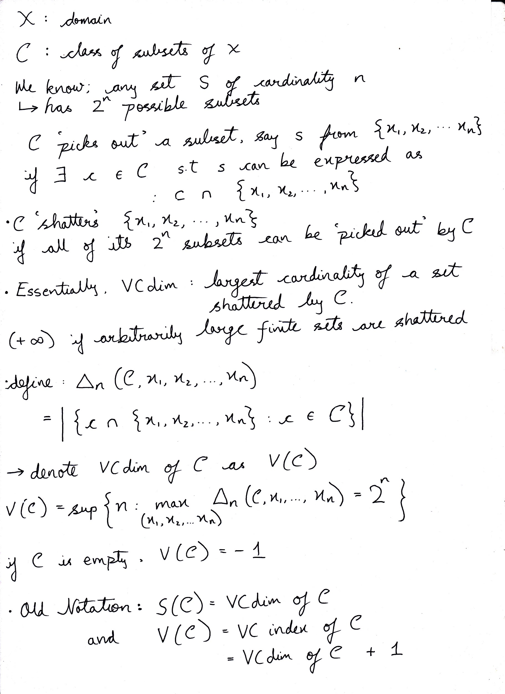

Slide 6


Slide 7
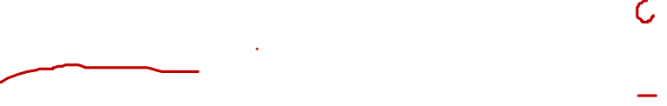

Slide 18
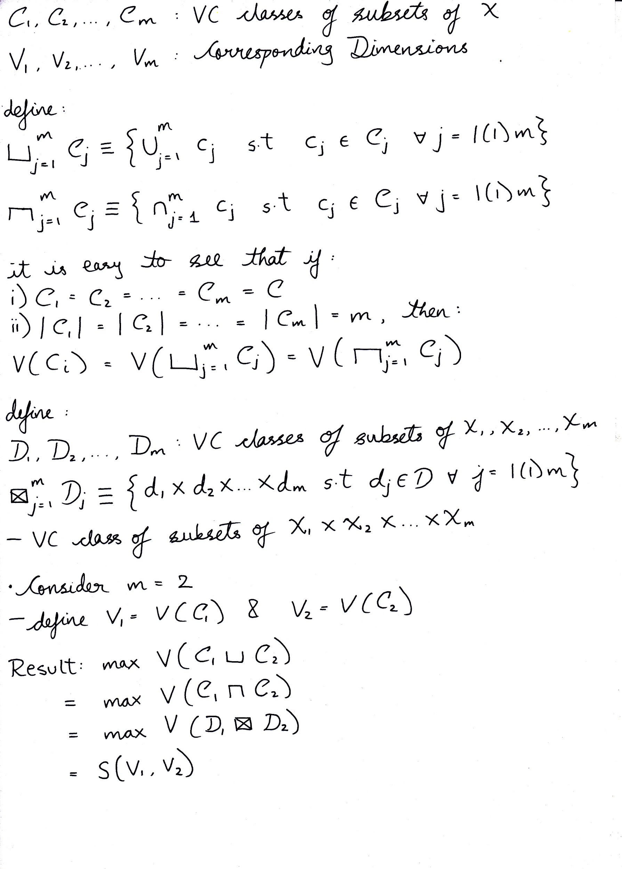

Slide 21
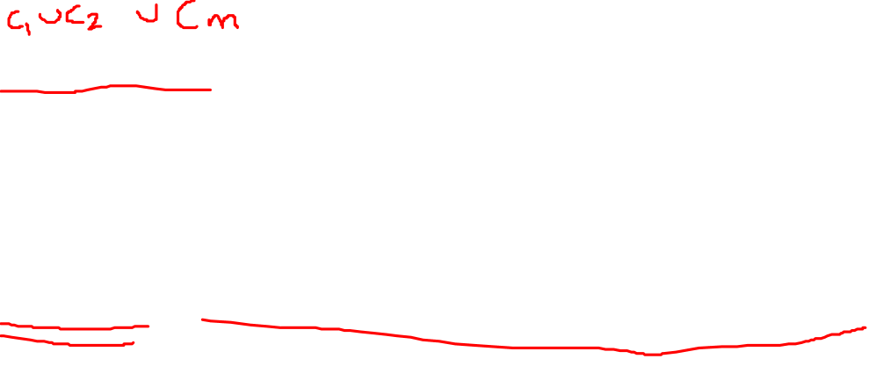

Slide 22


Slide 26


Slide 37
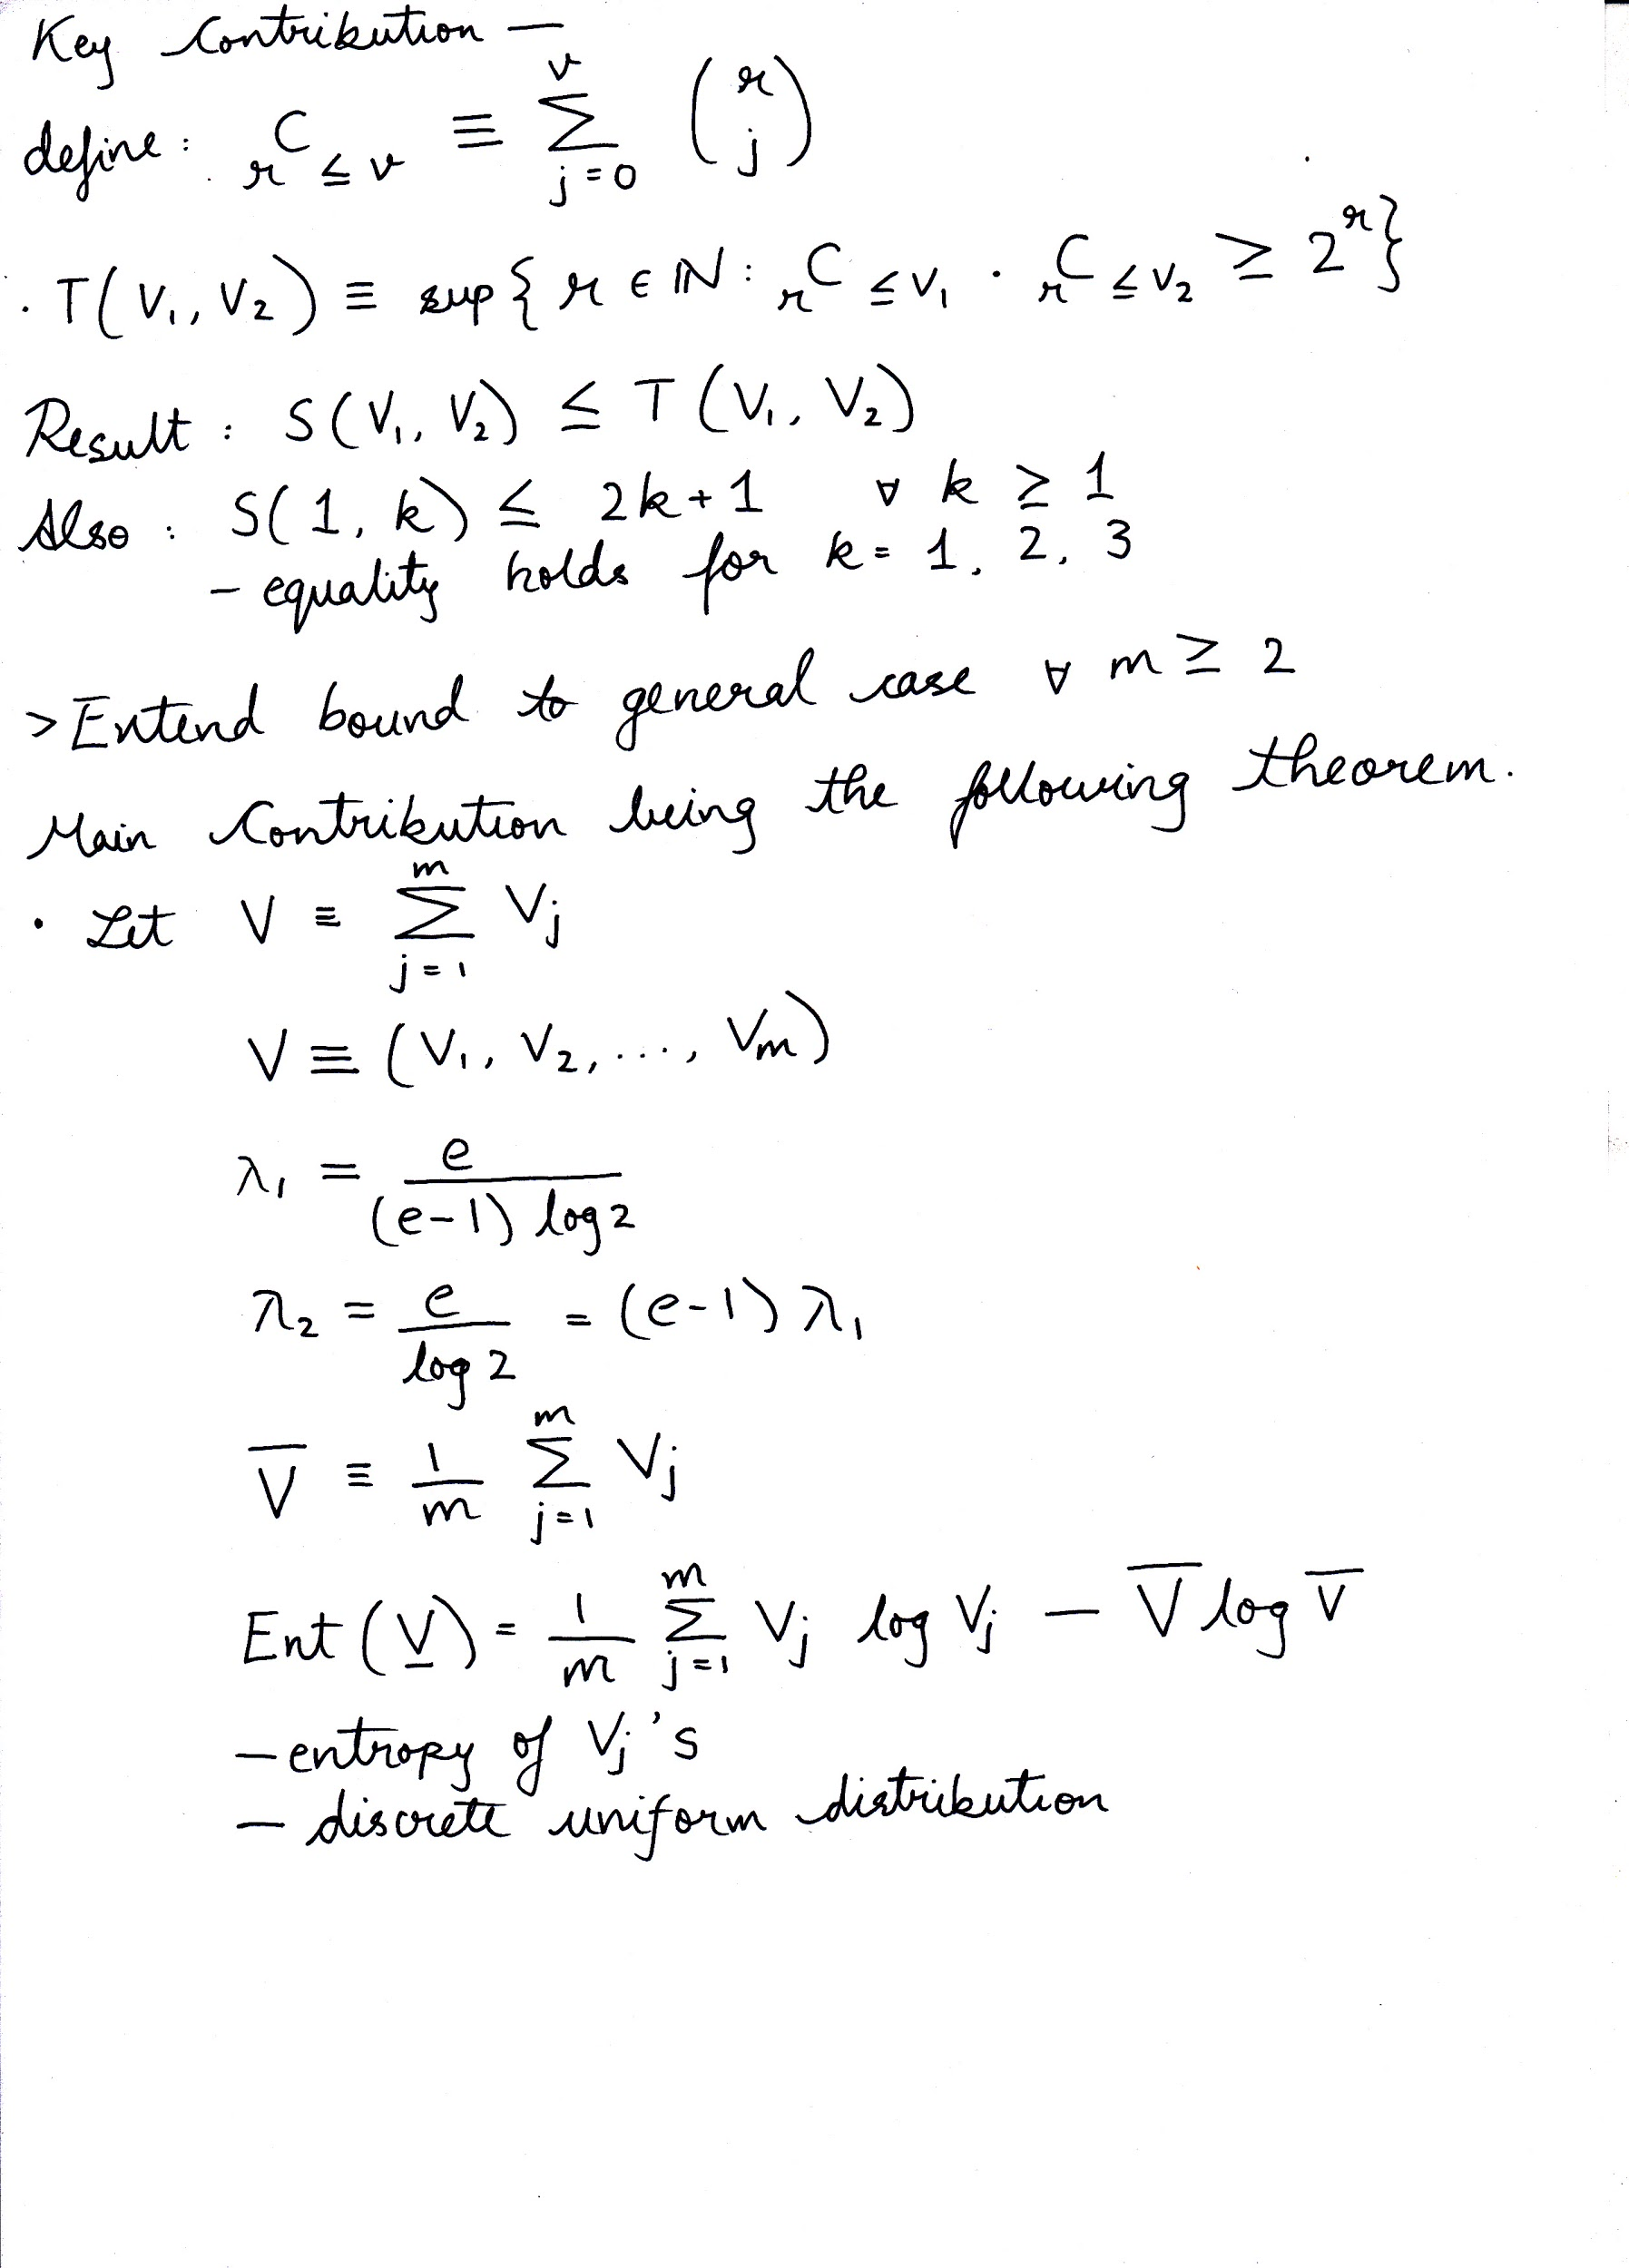

Slide 38


Slide 50


Slide 54
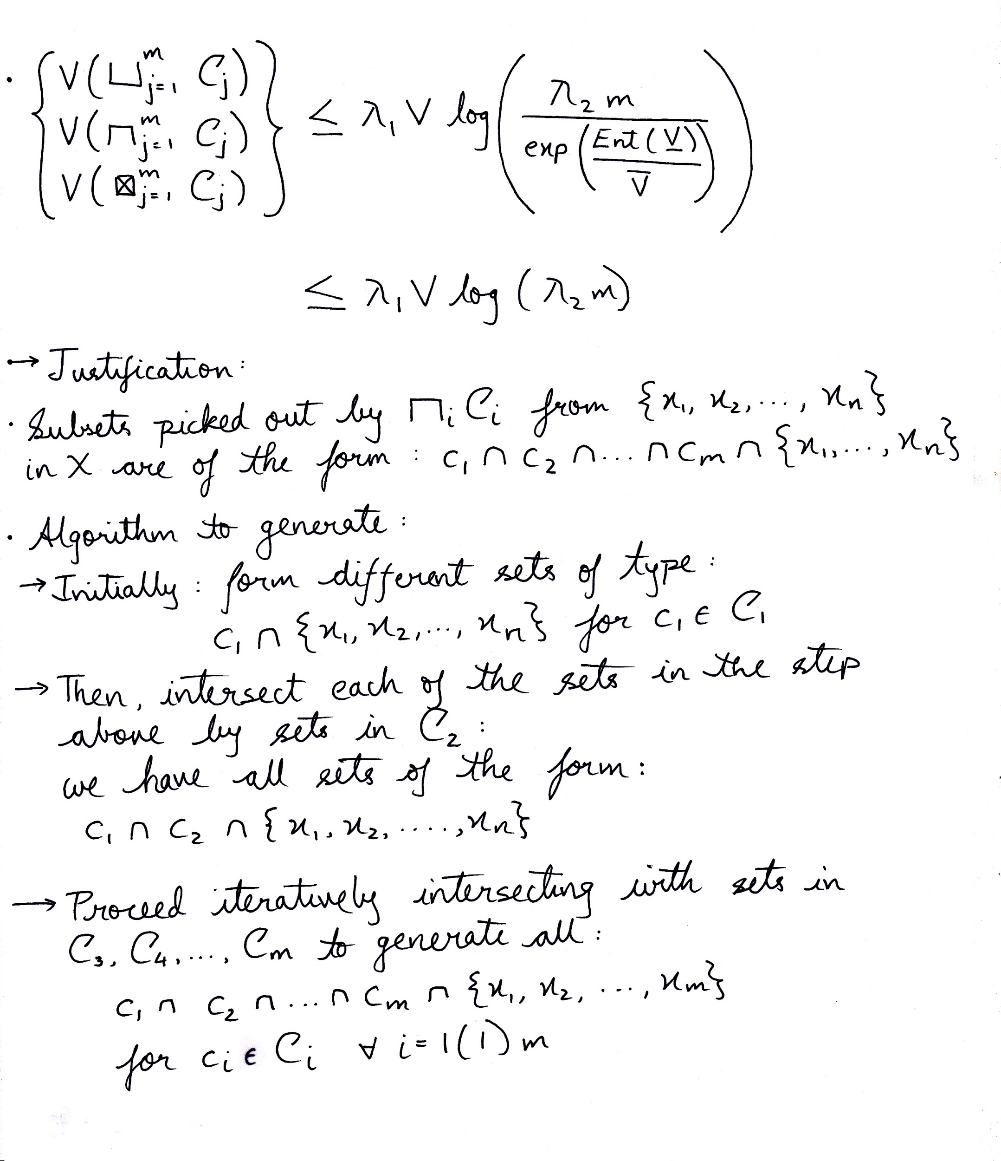


Slide 57


Slide 65
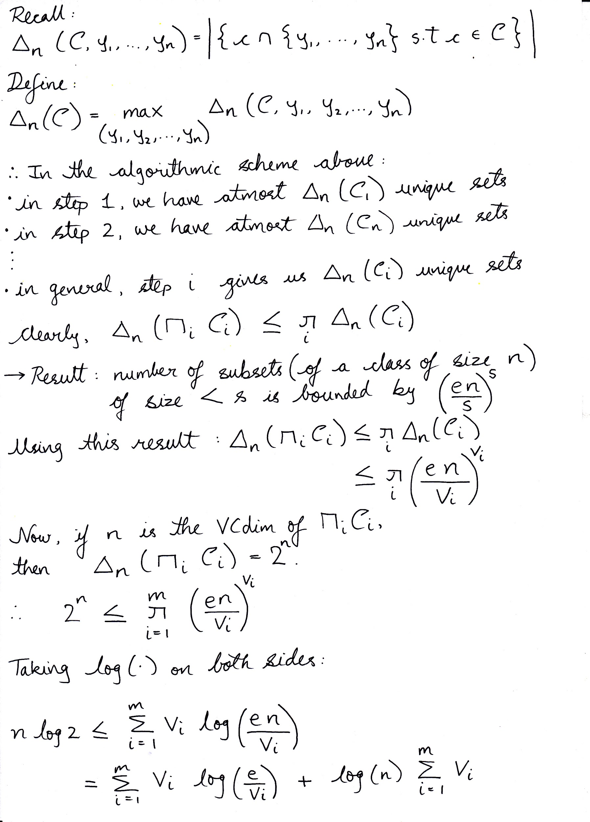

Slide 66


Slide 69


Slide 73


Slide 79


Slide 83
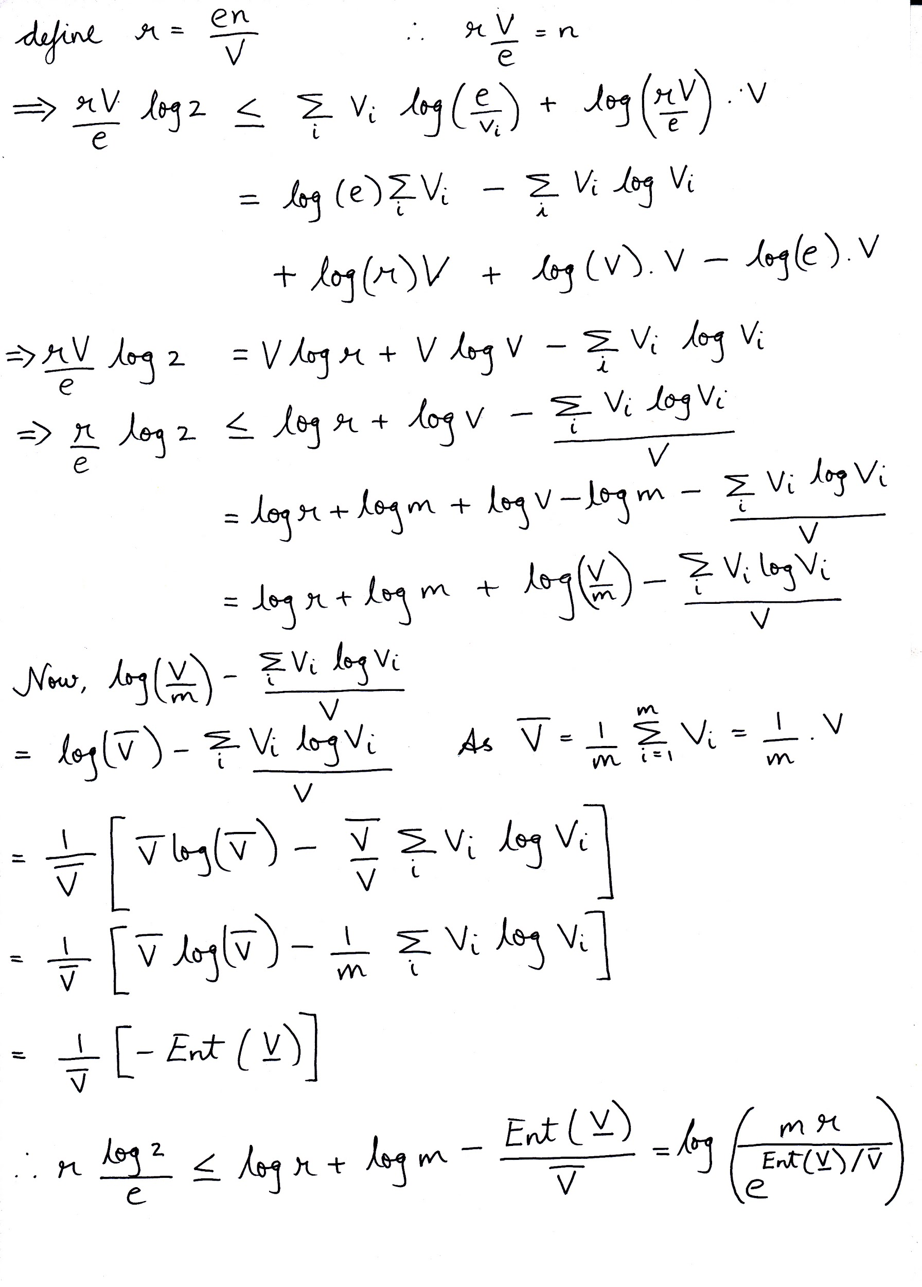

Slide 85


Slide 86
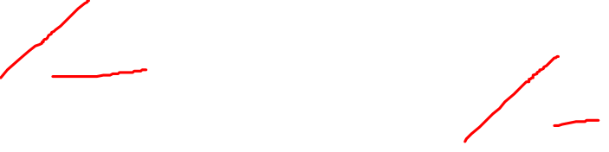

Slide 89


Slide 90


Slide 94


Slide 95


Slide 96


Slide 97
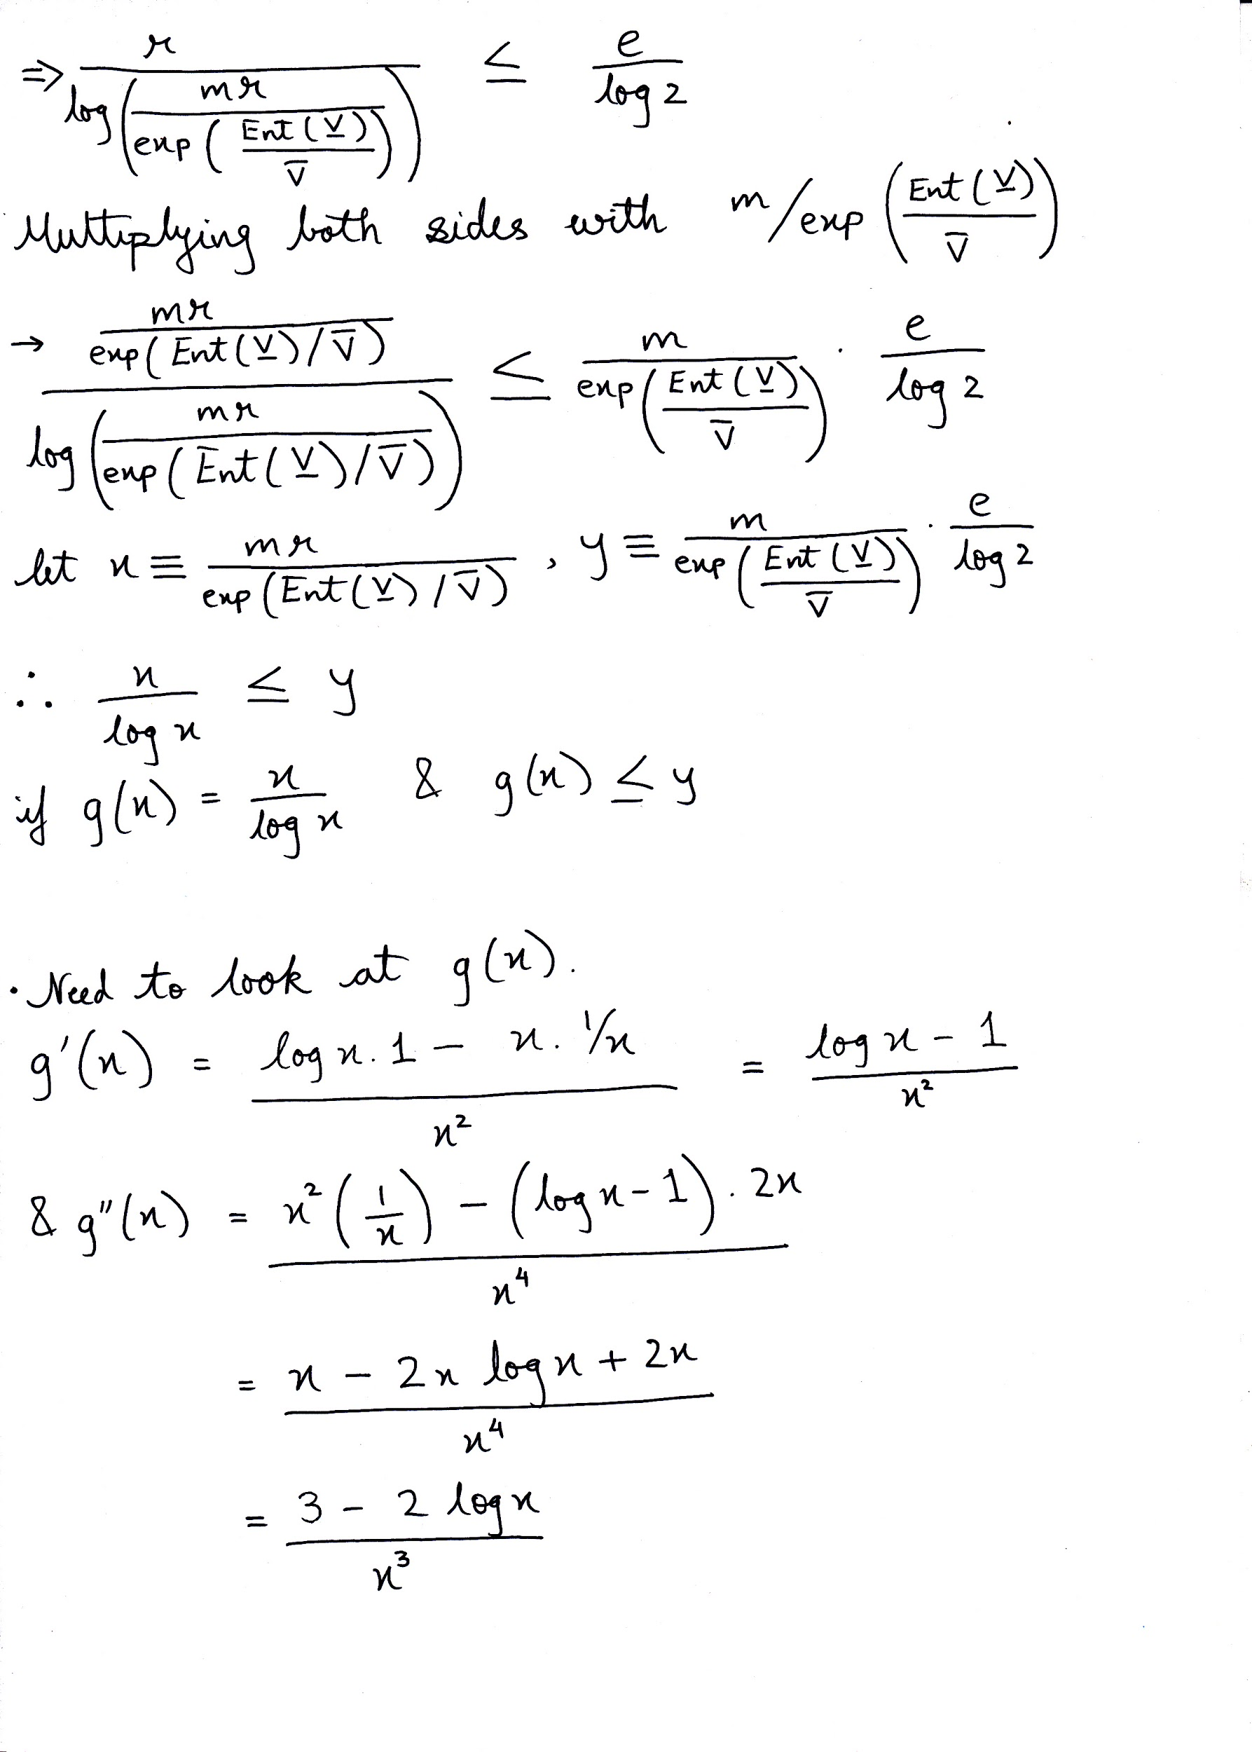

Slide 98


Slide 99
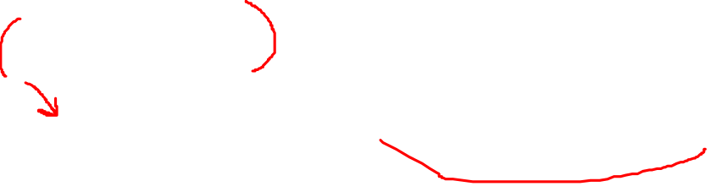

Slide 100
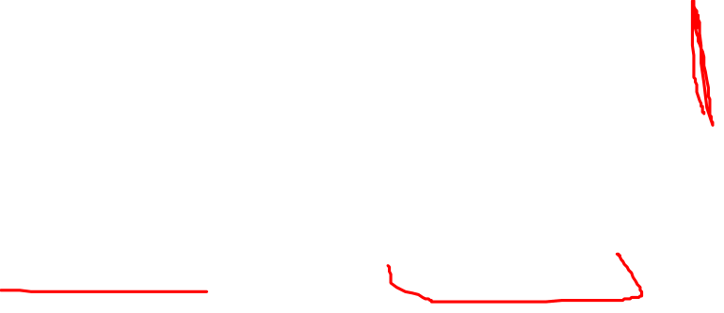

Slide 105
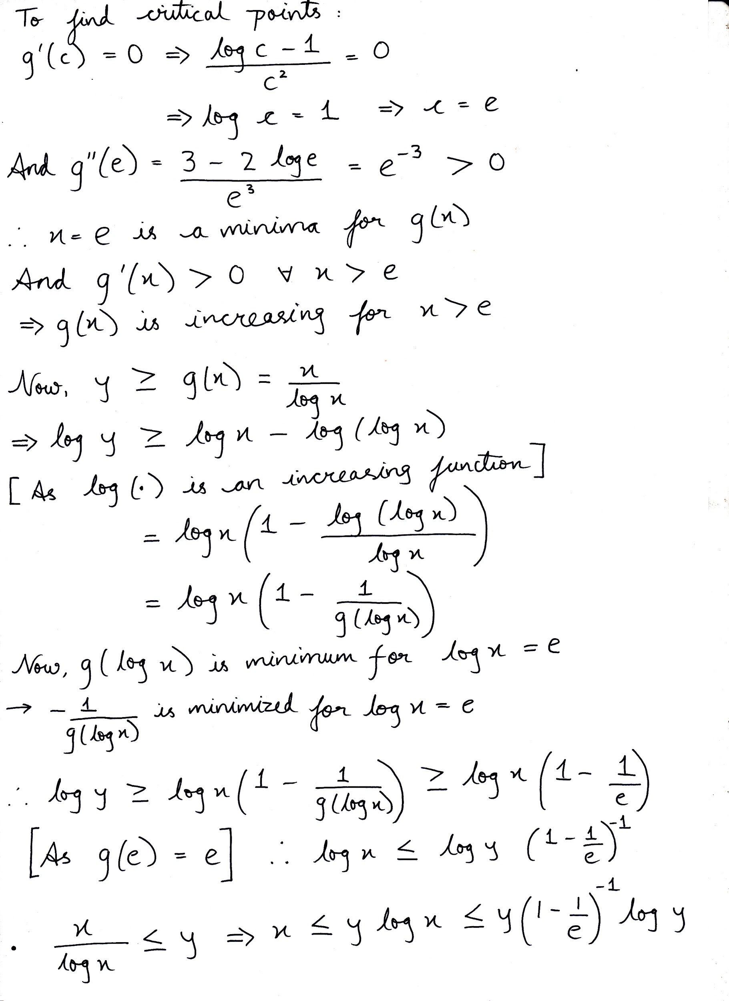

Slide 115


Slide 119
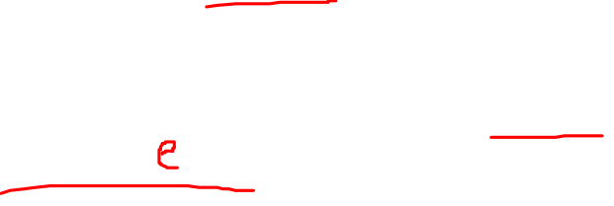

Slide 120
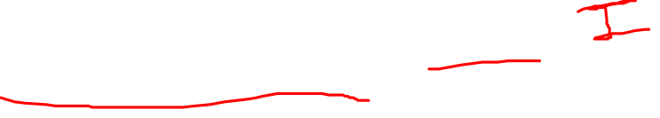

Slide 122
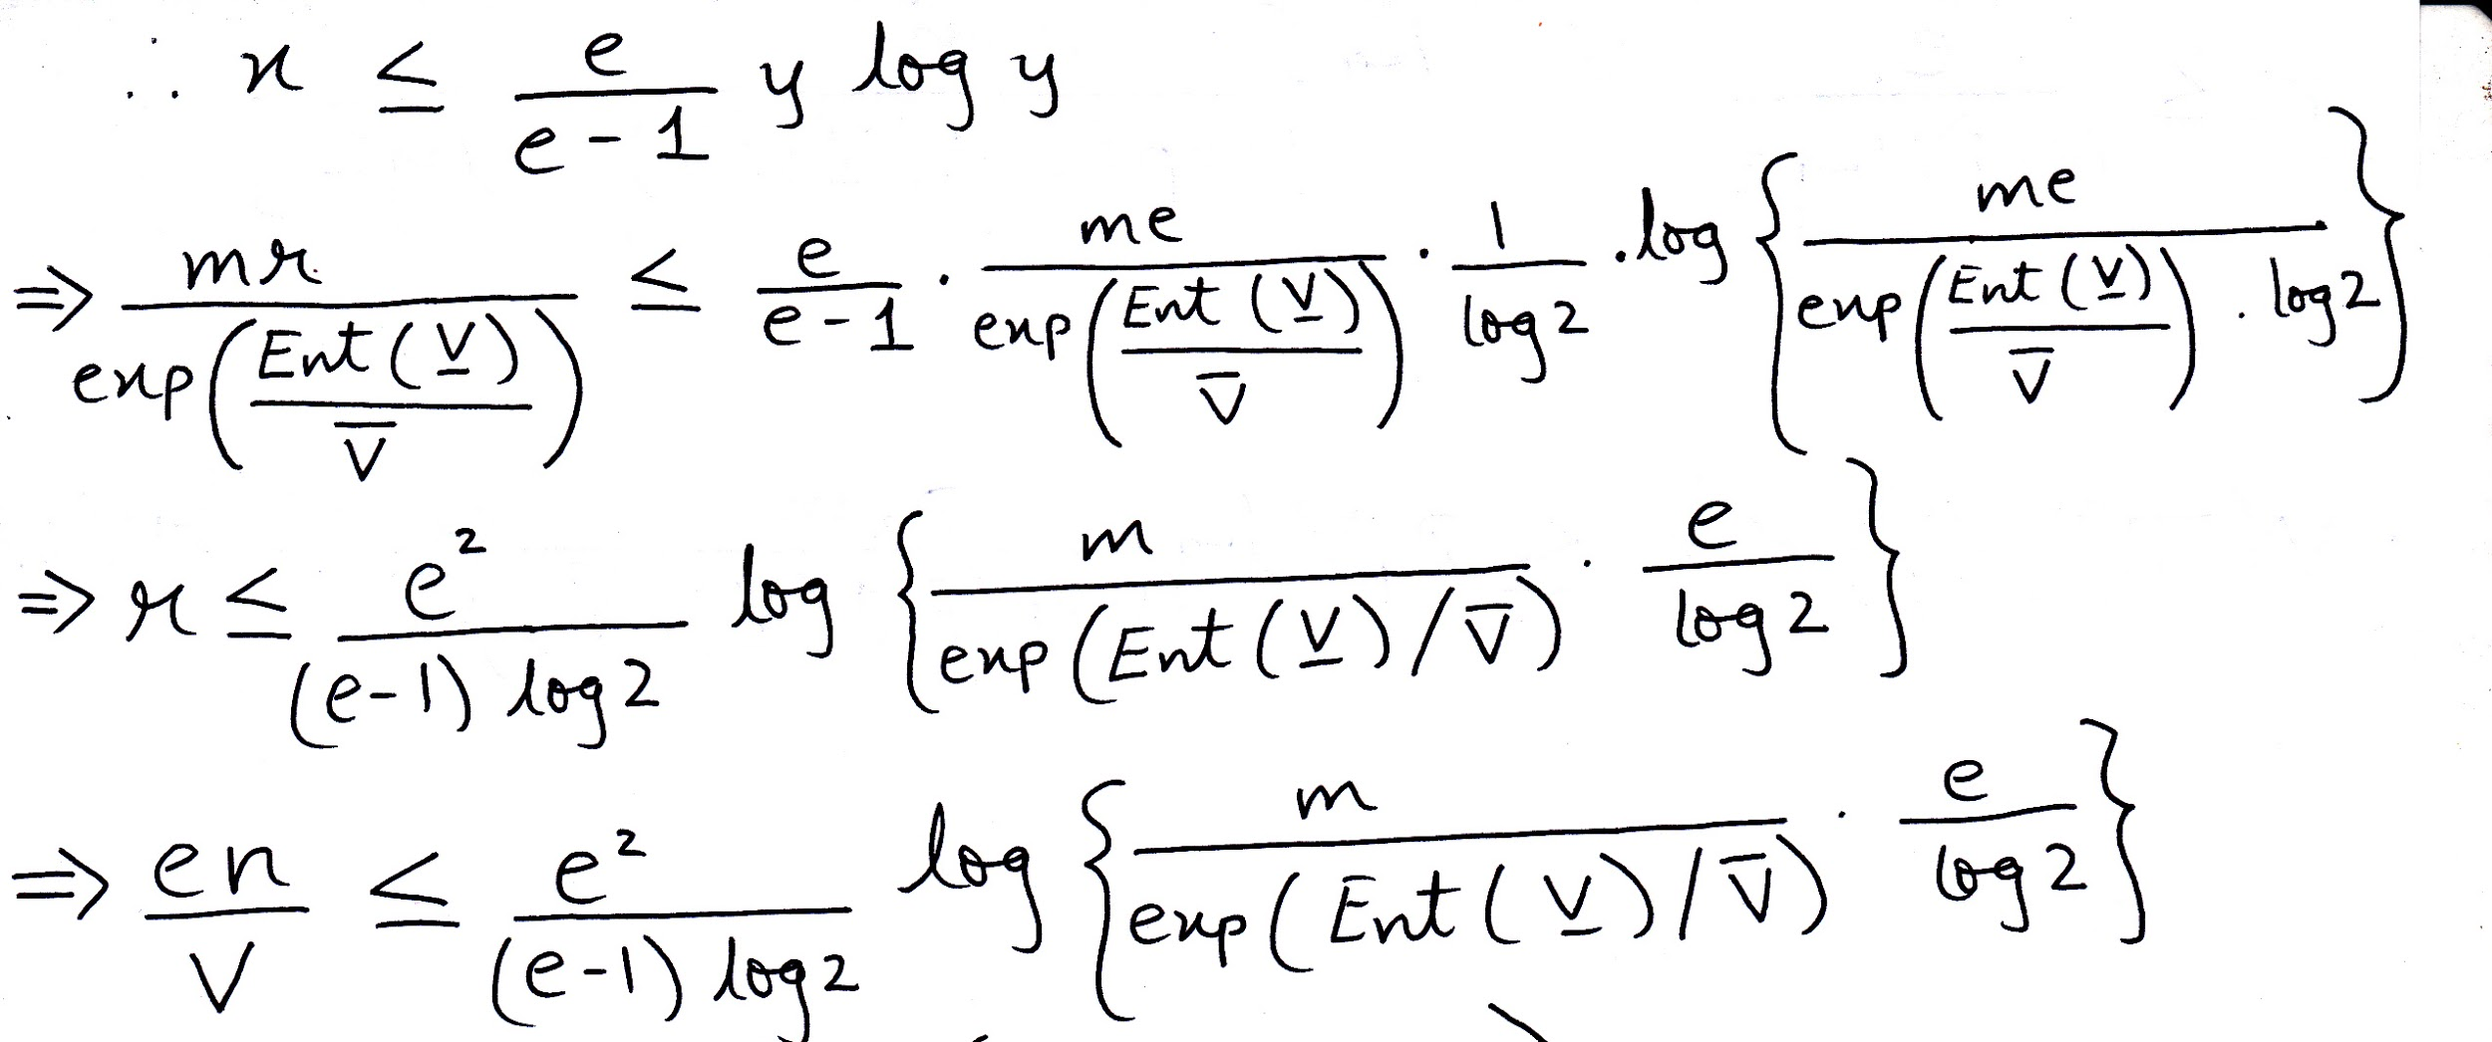

Slide 123
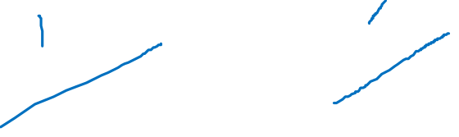

Slide 124


Slide 125


Slide 126
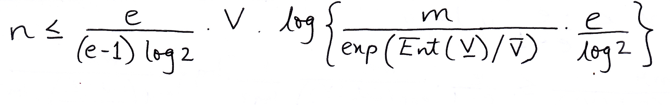

Slide 127
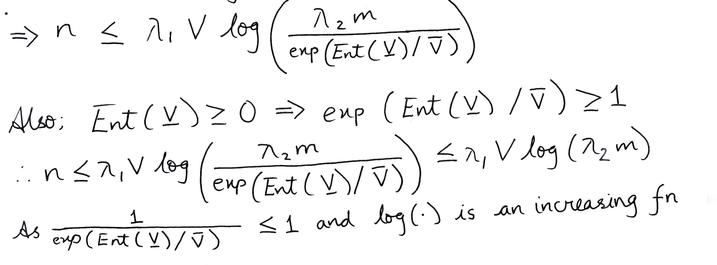

Slide 131
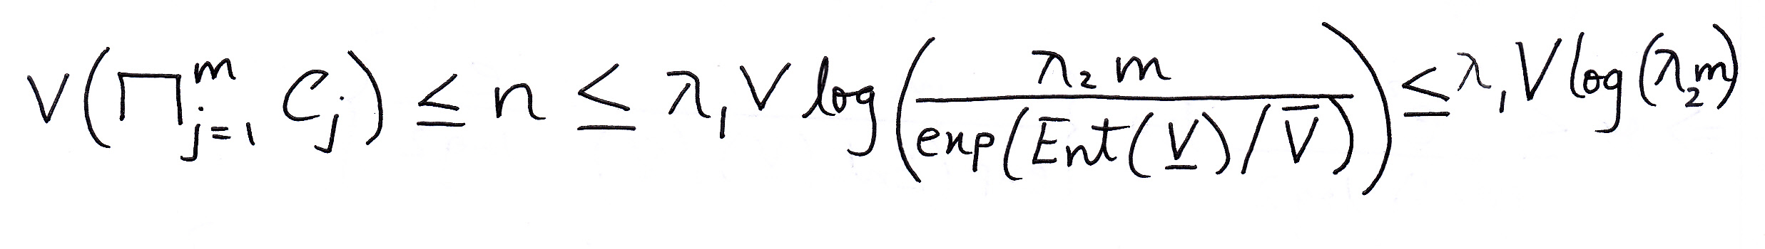
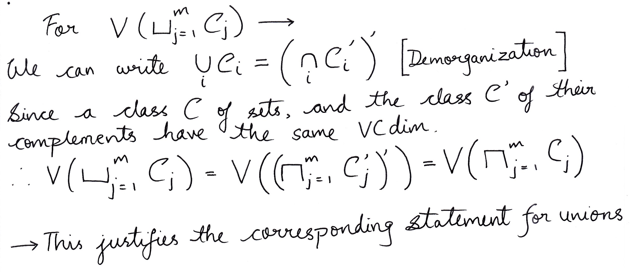


Slide 132
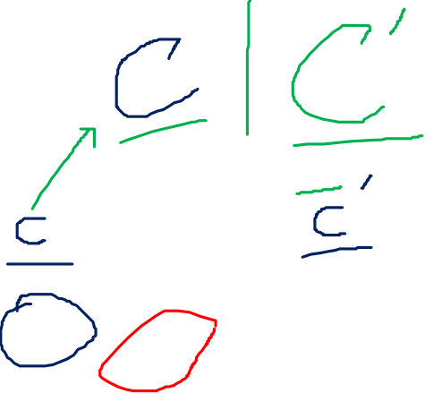

Slide 137
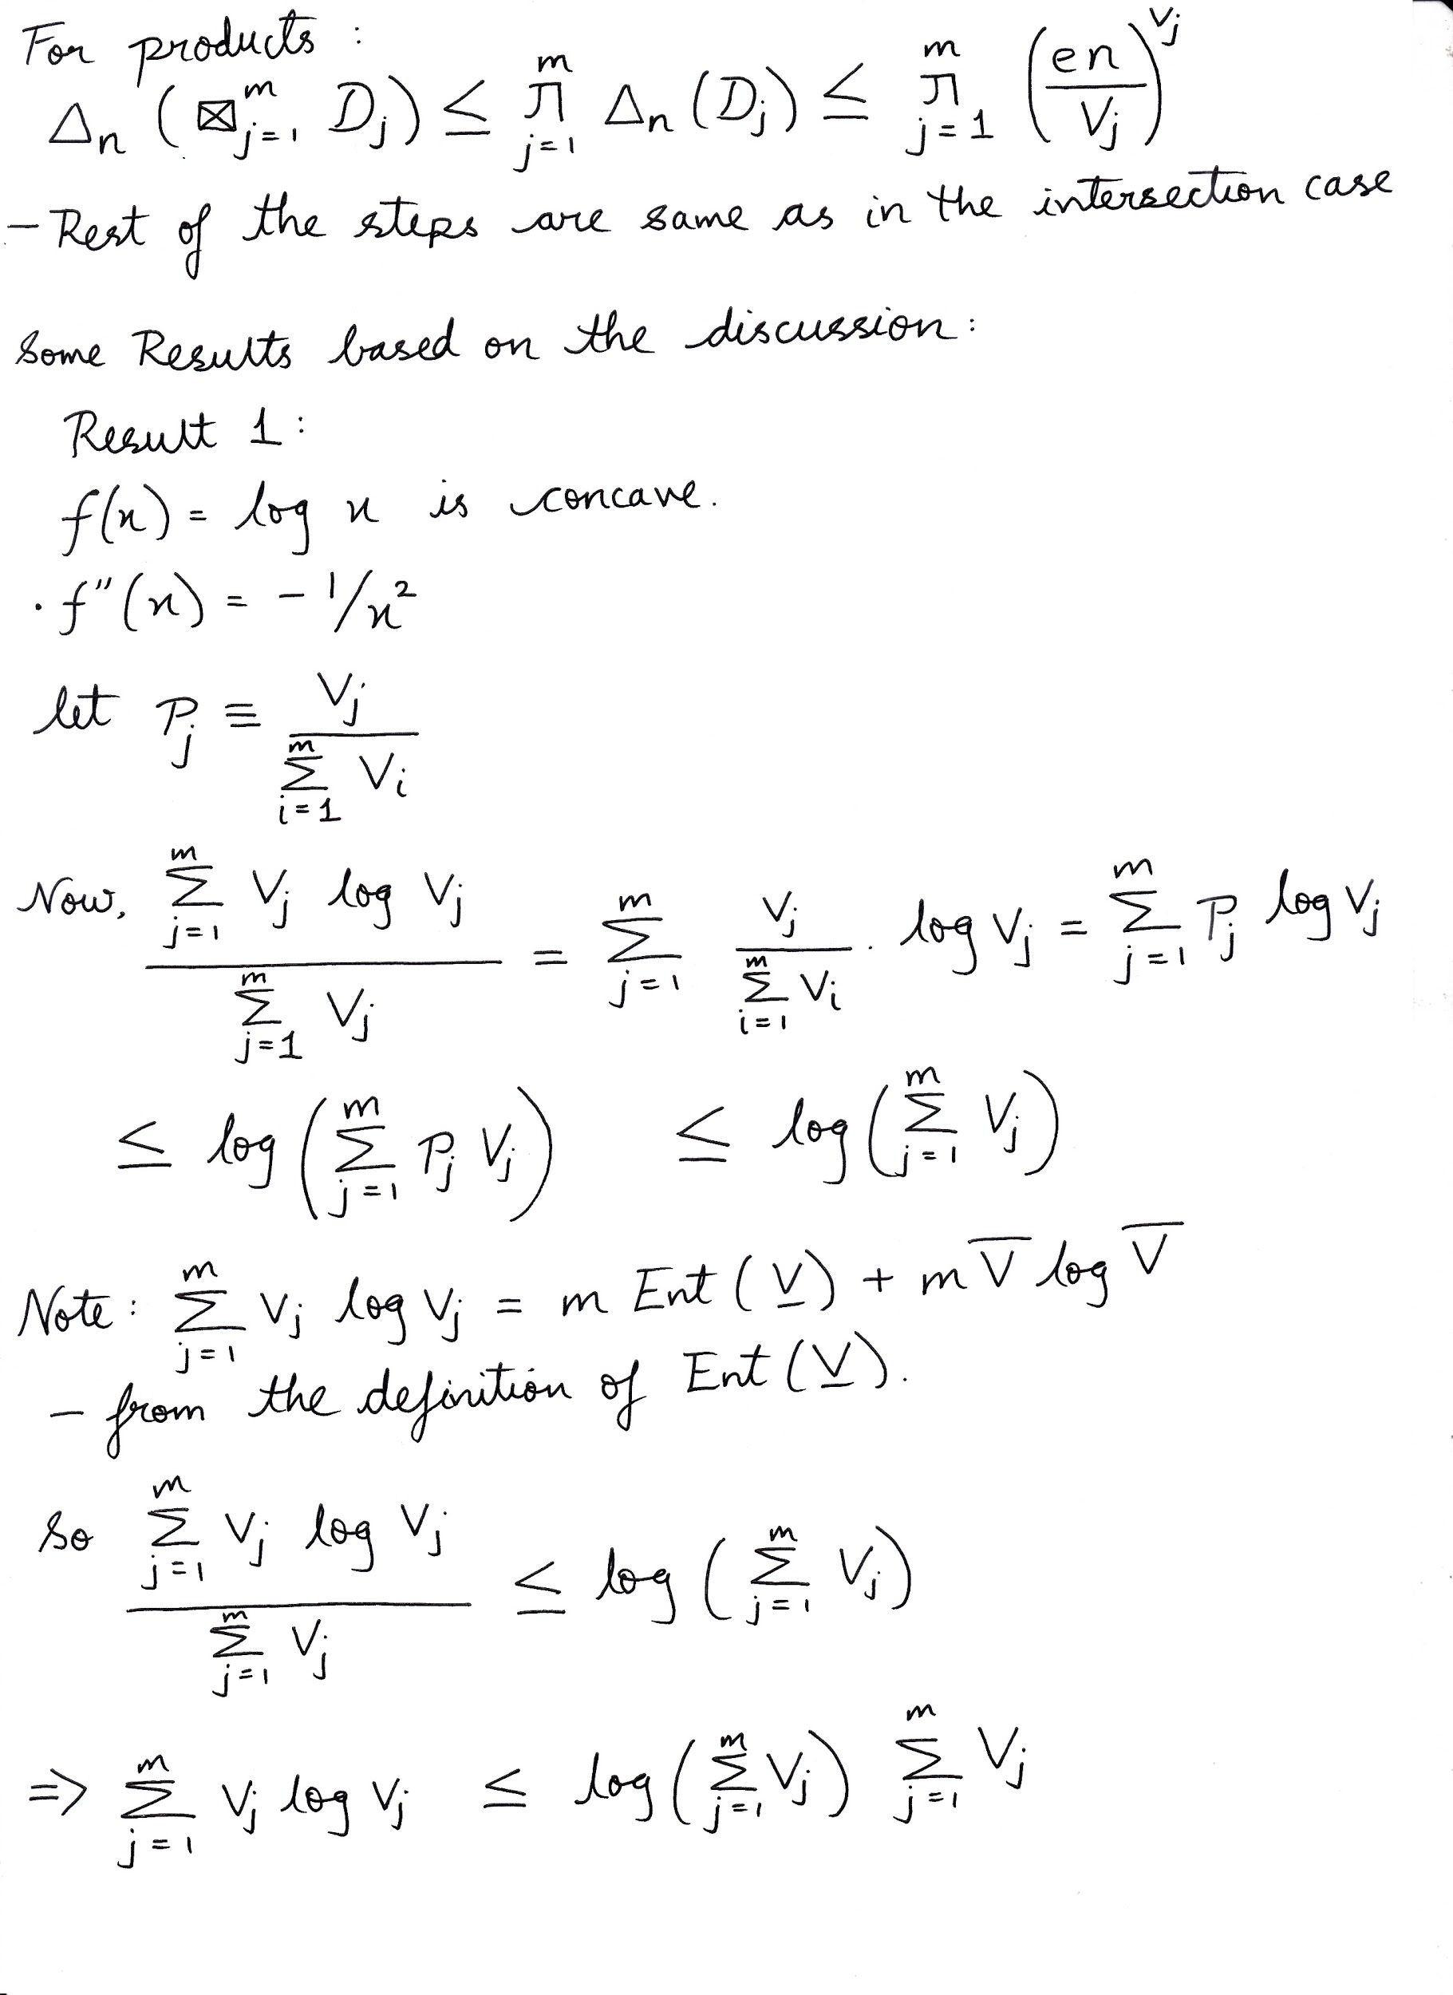

Slide 138


Slide 144
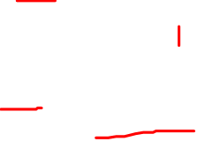

Slide 145
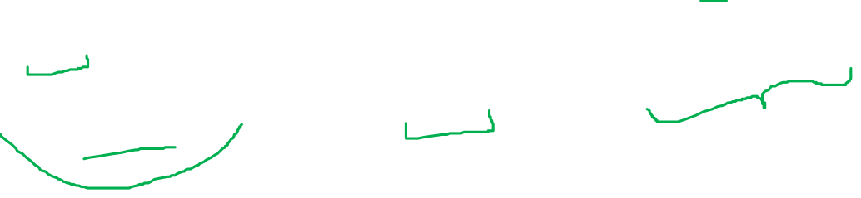

Slide 146


Slide 147


Slide 150


Slide 151
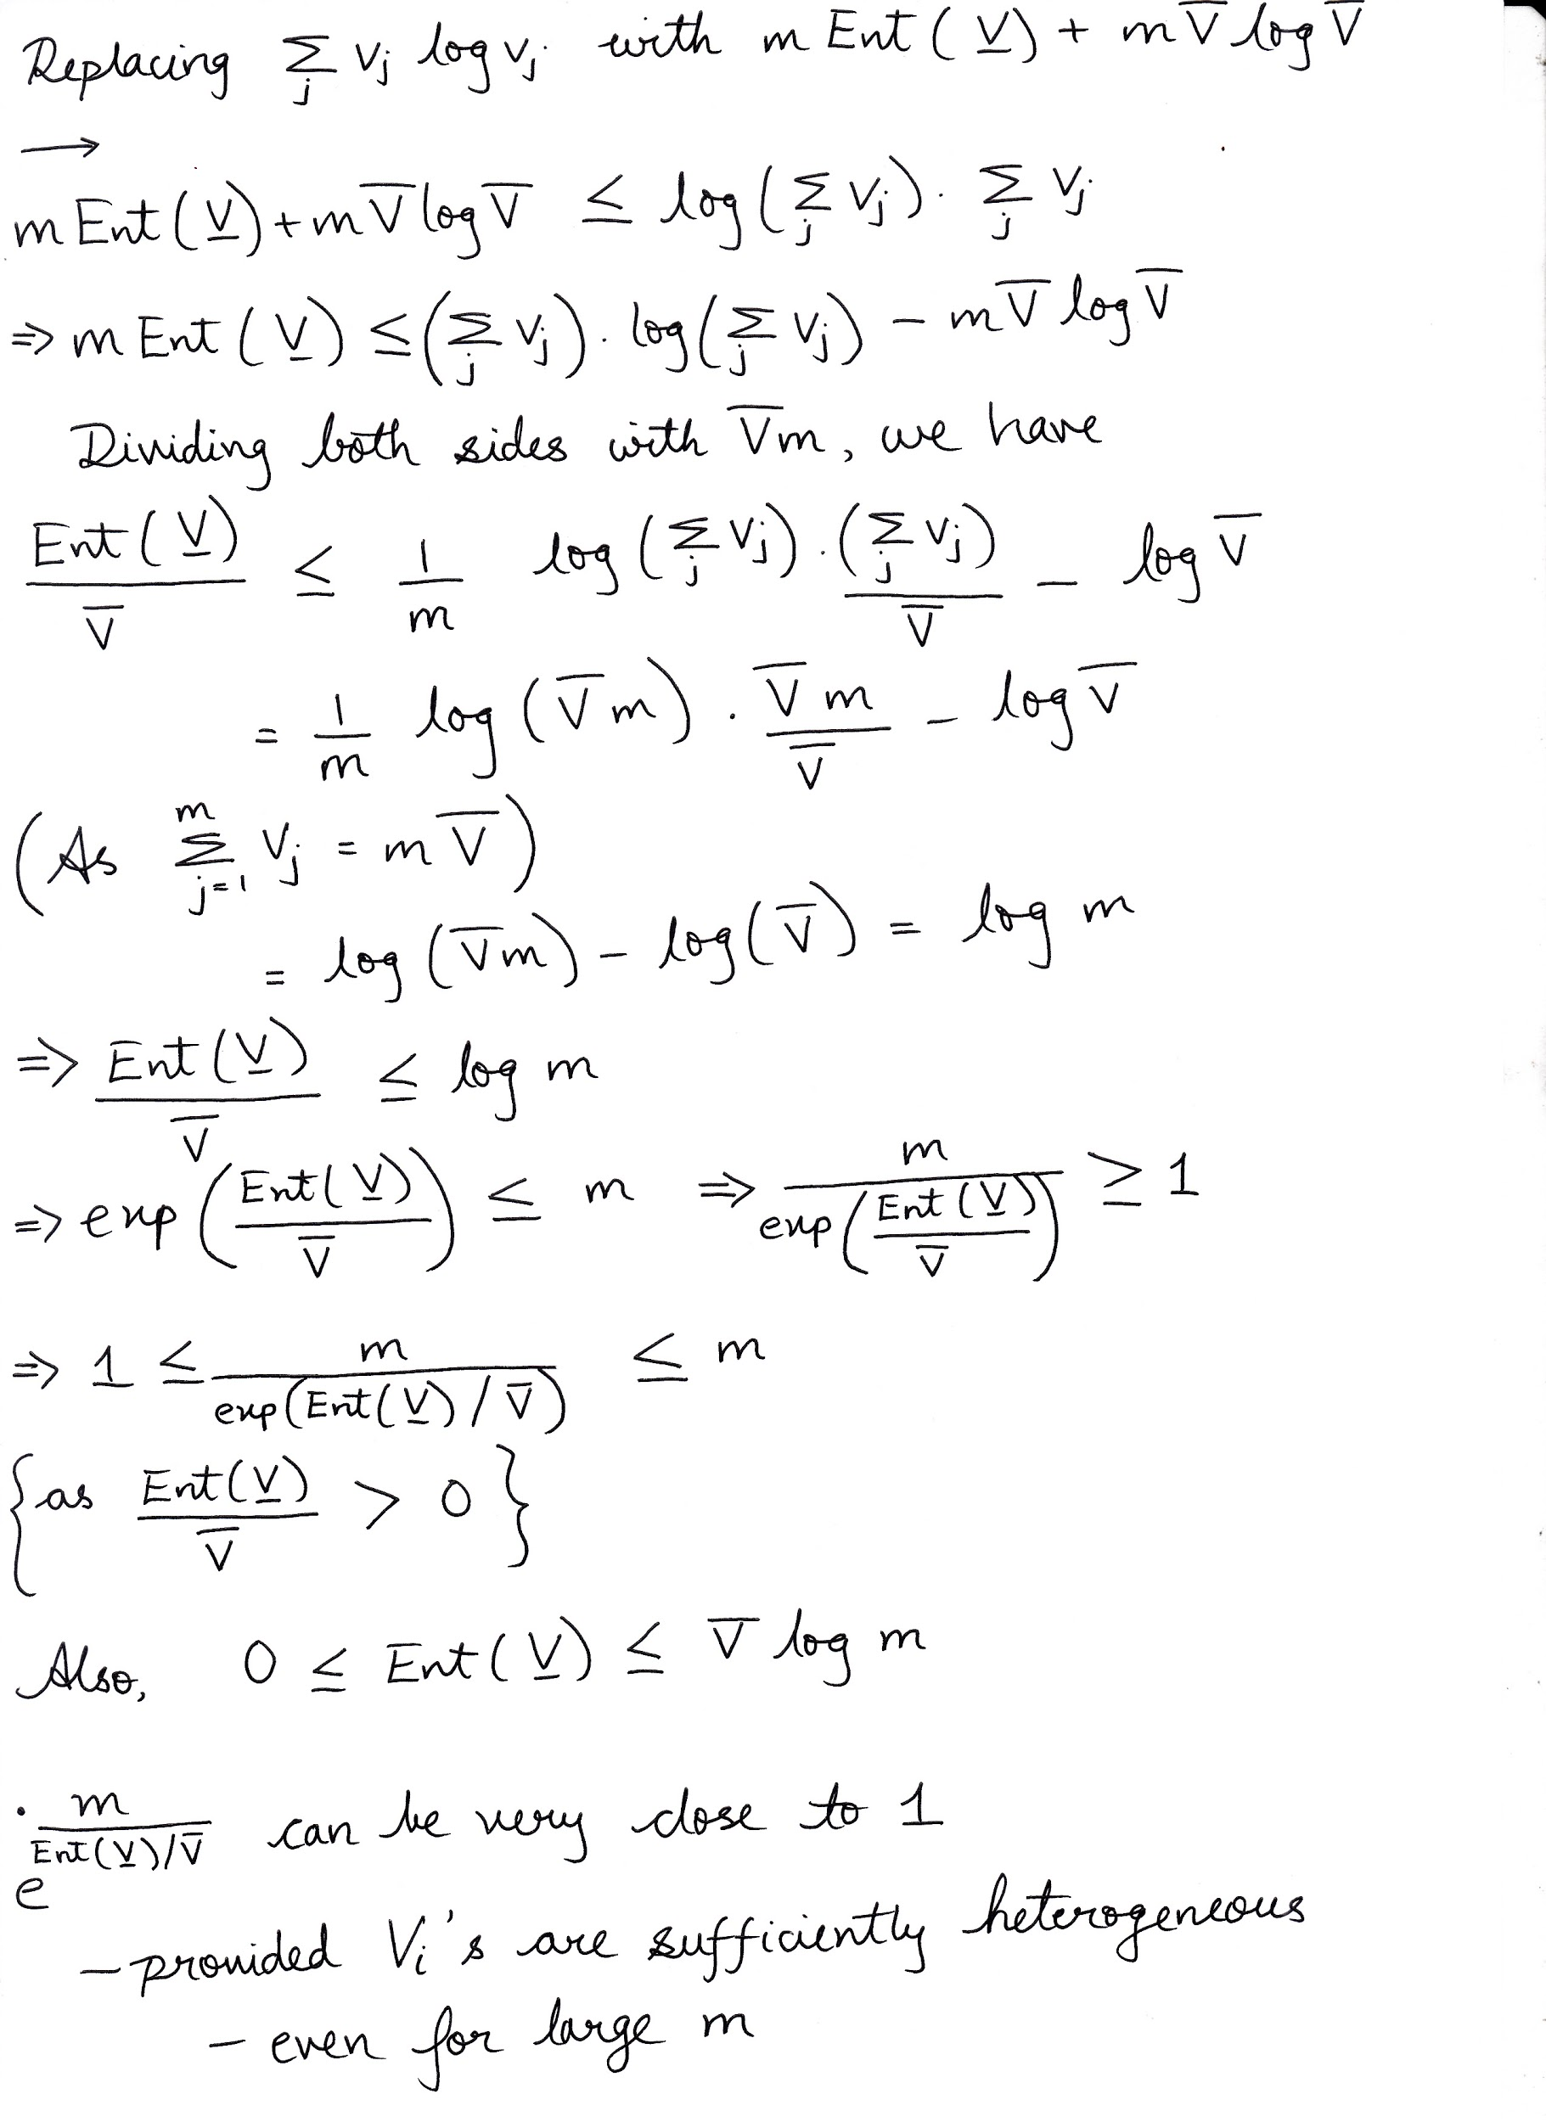

Slide 152
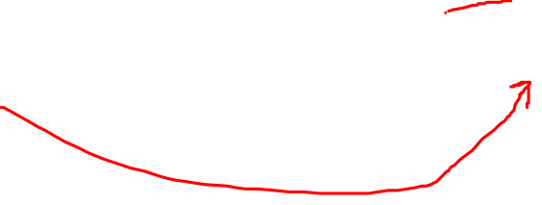

Slide 155


Slide 156


Slide 159


Slide 160


Slide 161


Slide 163
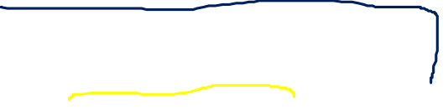

Slide 167
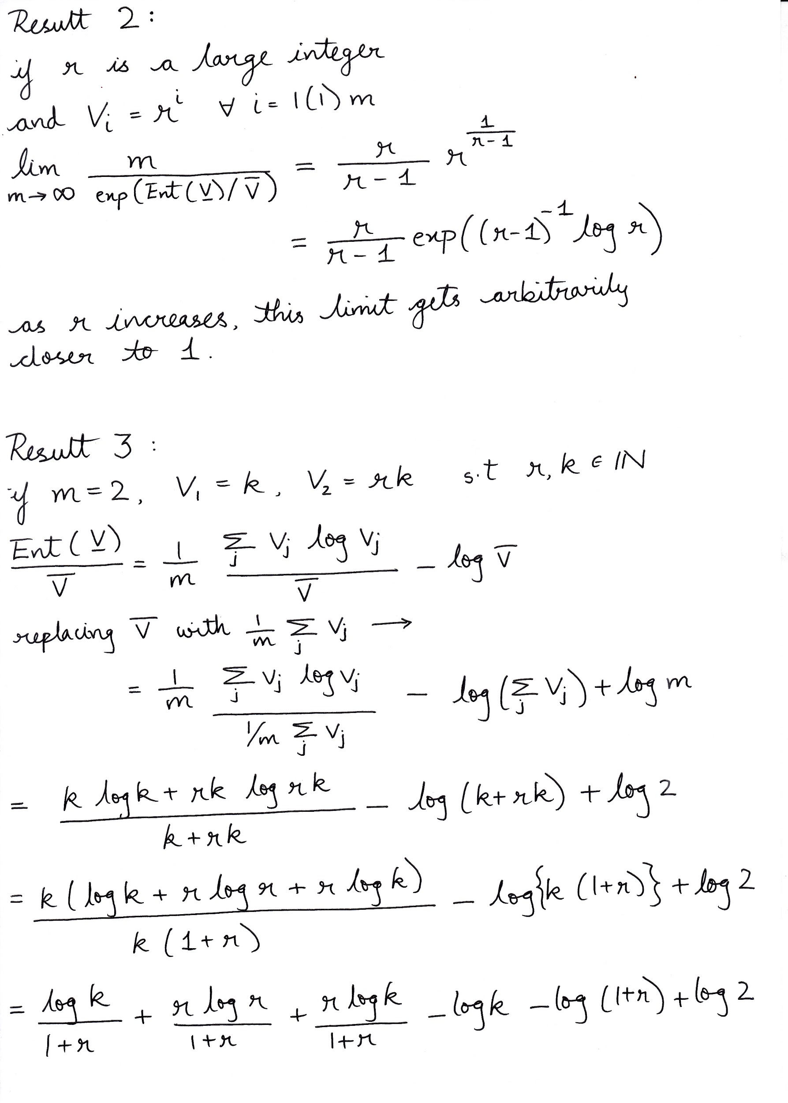

Slide 172
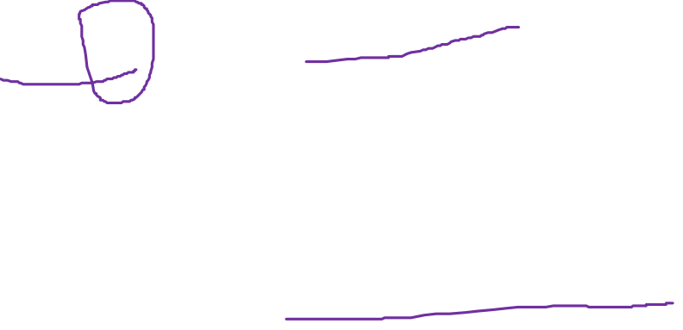

Slide 175


Slide 178


Slide 179


Slide 181
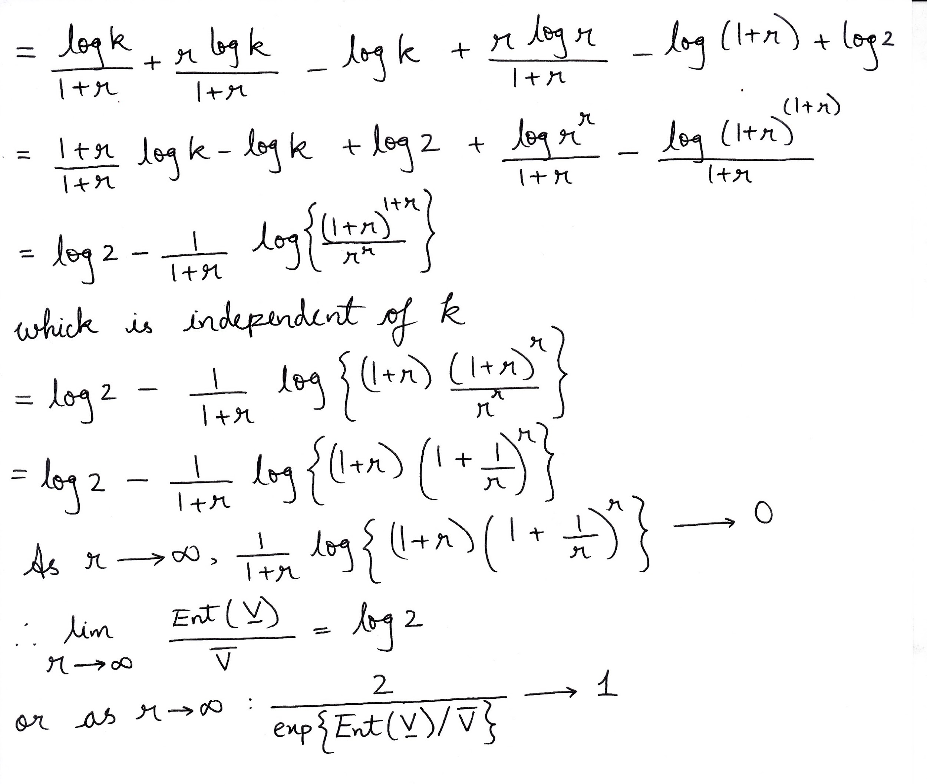


Slide 182


Slide 183


Slide 185
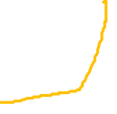

Slide 187


Slide 188


Slide 190

Thank You

